Slide 1


Data Worth Exploring
Jeff Winchell

Slide 2
Medicaid Drug Utilization
The Goal
Find New Value in Mountains of Existing Data
The Data
Utilization and Costs By Quarter and State
How We Got There
Accessing Cleaning Extracting Insights

Slide 3


Slide 4
Medicaid Drug Data
Cost and Usage
Drug
Where and When
Fee-For-Service or Managed Care Org
Reimbursed Amount: Medicaid or Other
Prescription Count
Units Prescribed
Unique Code
Product Name
Manufacturer (Derived Data)
Quarterly since 1991 (Prototype uses 2016,2018,2020 – 15 million records)
State
State Population by Year (Derived Data)

Slide 5

Steps to Get There
Download data from Medicaid.gov
Import data into SQL Server table
Remove records summarizing very few users (privacy issue)
Remove redundant derived columns
Add lookup tables:
state population by year from census.gov
Manufacturer of drug code from fda.gov
Manually add missing manufacturer name/drug
Collection of concise programs: http://Github.com/Jeff-Winchell/Medicaid-Drug-Utilization

Slide 6


After much curious playing with ad-hoc SQL queries three queries emerge, presented via Power BI dashboard…
Steps to Get There

Slide 7
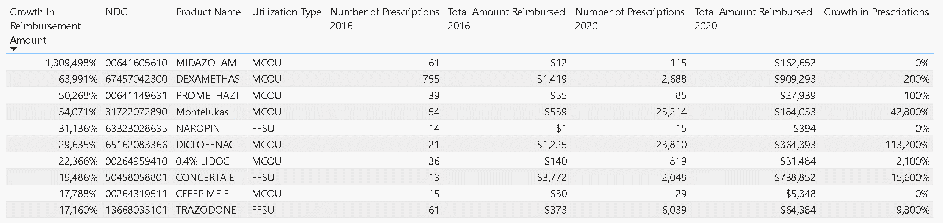
Do some drugs show extreme utilization growth?
Further exploration of those specific drugs could be valuable to see how much is due to medical efficacy vs. financial concerns.

Slide 8
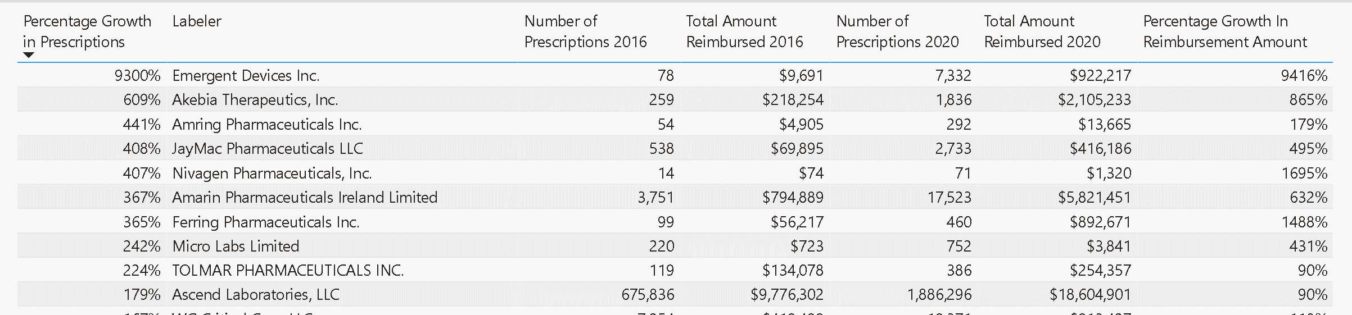
Do some manufacturers drive utilization growth?
Further exploration of those specific drugs could be valuable to see how much is due to medical efficacy vs. financial concerns.

Slide 9
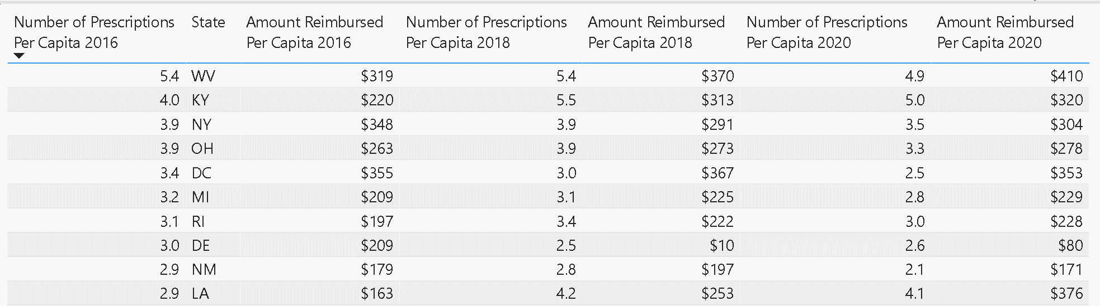
Do regional practices lead to different patterns of drug usage?
If so, what are the causes? What caused major utilization growth in 2018 vs. 2016 in Louisiana?

